Slide 1

Group Software Development Project
Client Projects

Slide 2
The Clients
1. Elaros (Health and Wellbeing Tech)
2. IBM
3. Sci-Toolset
4. Highfield Qualifications
5. Dronfield Swimming Club
6. Elanco
7. The Saviour Trust (Homeless Charity)
8. Sky, Betting and Gaming
9. Sheffield University Dept of Psychology
10. XLN (Telecoms)

Slide 3

Elaros – Digital Health
Elaros is a private digital health company incubated by NHS organisations
Produces innovative technology to support health care professionals
Previously worked with SHU on application development

Slide 4
Long Covid
Project to Digitalise an internationally acclaimed screening questionnaire for Long Covid patients
Application
Requires questionnaire development – mobile app, web app, web pages
Web Portal for data display visualization and export

Slide 5

Track record of successful projects with IBM
Fourth year they have been involved with the module
Previous student projects been demonstrated at various tech conferences

Slide 6
Create a 3d/VR Digital Collaborative Environment

Slide 7



Slide 8

Sci-Toolset has a UK based placement opportunity
Sci-Toolset is part of Collins Aerospace is a leader in technologically advanced and intelligent solutions for the global aerospace and defense industry
Collins Aerospace has 70,000 employees, with an engineering workforce of over 16,000, based at 300 sites globally. With annual sales of $23 billion and a $3.1 billion research and development investment

Slide 9
The Project is to develop some analytics software which uses their API to interrogate an instance of SCi-Discover
The application should show the percentage coverage of a geographic area covered by products held in SCi-Discover and visualise the GeoJSON associated with these products on a map
Sci-toolset are opening their SCi-Discover API for you to use

Slide 10

Remote Invigilation Tool

Slide 11
Once a learner logs in, the system will allow an invigilator to view a list of learners waiting to take an exam, the invigilator can then select a learner and they will be logged as the invigilator against that learner.
• The system should display the learners face via a web cam to the invigilator before starting and during the exam
• The system should display a learner’s screen to the invigilator while they are taking the exam
• Invigilators should be able to note down any cheating for a specific learner during an exam.

Slide 12
Dronfield Swimming Club
Membership Tracking App
Android and/or Mobile Web App
Must be secure
Will hold data for Club members under 16

Slide 13
Technology to be suggested and negotiated through discussion with the client
Could potentially be extended to commercial club management service
Dronfield Swimming Club

Slide 14

US Pharmaceutical Company which produces medicines and vaccinations for pets and livestock
Former SHU Graduates supervising the Project

Slide 15

Digital Receipts: Proof of Technology
Elanco wants to explore the use of cloud-based cognitive services to complete text analysis on customer receipts
Will require access to Azure Cognitive Services image-to-text to extract key details from images and receipts

Slide 16

Saviour Trust would like an app that can be used by staff to share information in real time.
The Trust has a number of properties for its clients.
Clients are visited every week and a paper copy visit sheet completed.
The information is then shared with support managers at the end of each day.
Charity based in Pontefract
Support homeless and those at risk of becoming homeless

Slide 17
The Trust would like an app that would replace the paper-based system allowing house visitors to fill this information in online.
Ideally the system would then send this information to a relevant worker creating a job/ task.
Technology: The Trust has no preference for any particular technology. Teams choosing this project should also advise the Trust on appropriate technical solutions.
Charity based in Pontefract
Support homeless and those at risk of becoming homeless

Slide 18


Based in Sheffield and Leeds
Track record of recruiting SHU graduates

Slide 19
Project One
HTML5 / Canvas Game
Holding Page Game
To respond to Twitter API when services available
Project Two
Age verification System
Amazon Recognition Services for Scanning documentation such as Passports and/or Drivers License

Slide 20

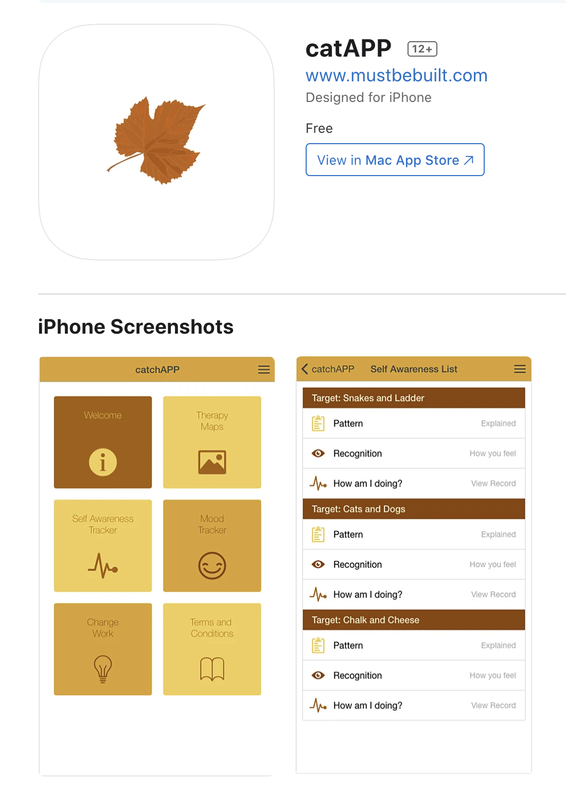

Cognitive
Analytic
Therapy
(CAT) Engagement App (CatApp)

Slide 21
Develop Version 2.0 of an
Application used to support Cognitive Analytic Therapy Already published on iOS and Android
Client App
Allows entry of data by clients iOS and Android
Therapist Web Portal Allows creation of accounts and data visualization

Slide 22
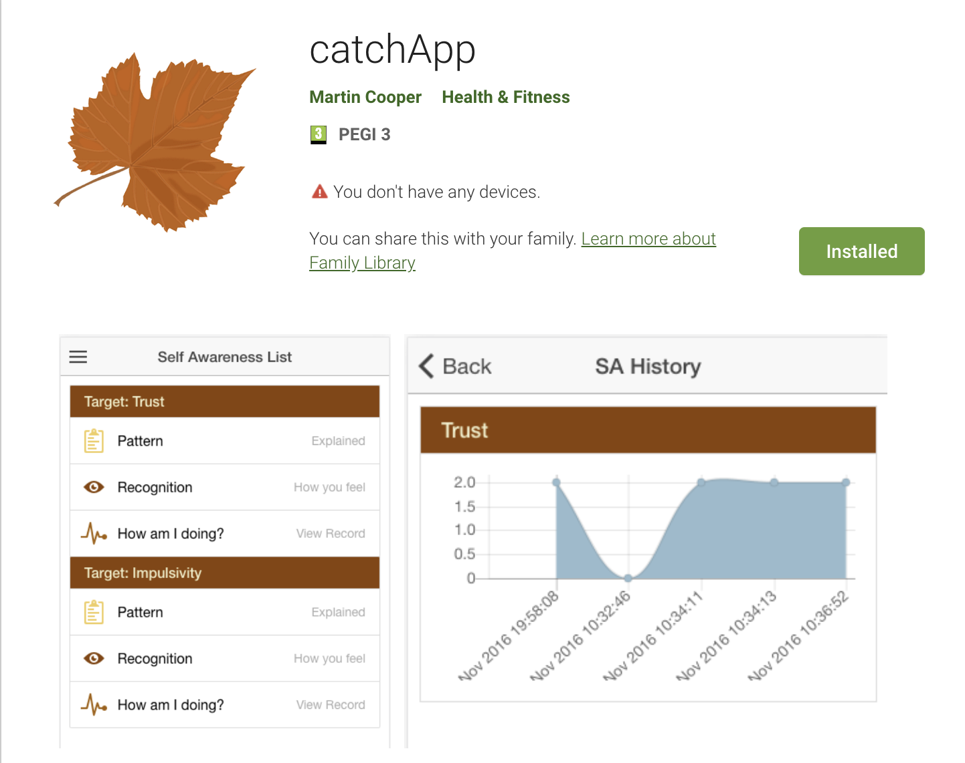

Slide 23

Telecommunications
Sheffield (and London) Based telecommunications company.
Phone lines, Broadband (ADSL, Fibre), Public Wi-Fi, Card Payment Services, Gas, Electric, VOIP and Mobile products aimed at small business.
Strong developer team with SHU graduates on the payroll.

Slide 24
Project Proposal - Fault reporting application.
Mobile application to log customers into their system and retrieve account details.
Allow for the logging of faults with images of fault to be uploaded at various stages
Troubleshooting Steps for resolving common faults
Stretch Goal – Chat Bot
XLN have SHU graduates in their development team
They currently have SHU students on placement
They have placement Opportunities for 2020/21

Slide 25

Time To Choose
https://forms.gle/7j4CQ9cxcHPGvwKk6

Slide 26
The Clients Revisited
Elaros (Long Covid App)
IBM (Digital Collaborative Environment)
Sci-Toolset (API Data Analysis and Visualization)
Highfield Qualifications (Remote Invigilation)
Dronfield Swimming Club (Membership App)
Elanco (Digital Receipts - Azure)
The Saviour Trust (Homeless Charity Data Collection)
Sky Betting and Gaming (Placeholder Game / Age Validation)
Sheffield University: CatchApp (Therapy App)
XLN (Fault Troubleshooting)
Choose a client by the 11.00am on Wednesday via the Google Form on Blackboard
https://forms.gle/7j4CQ9cxcHPGvwKk6

